Slide 1


Smart ID
Prepared by
Furkan Alahi
011161212
Maisha Farzana
011121237

Slide 2

Features
Tap once you are ready to go
More Secure
Access to class ,library, Lab equipment, Register office
Easy access to all student Activities history

Slide 3
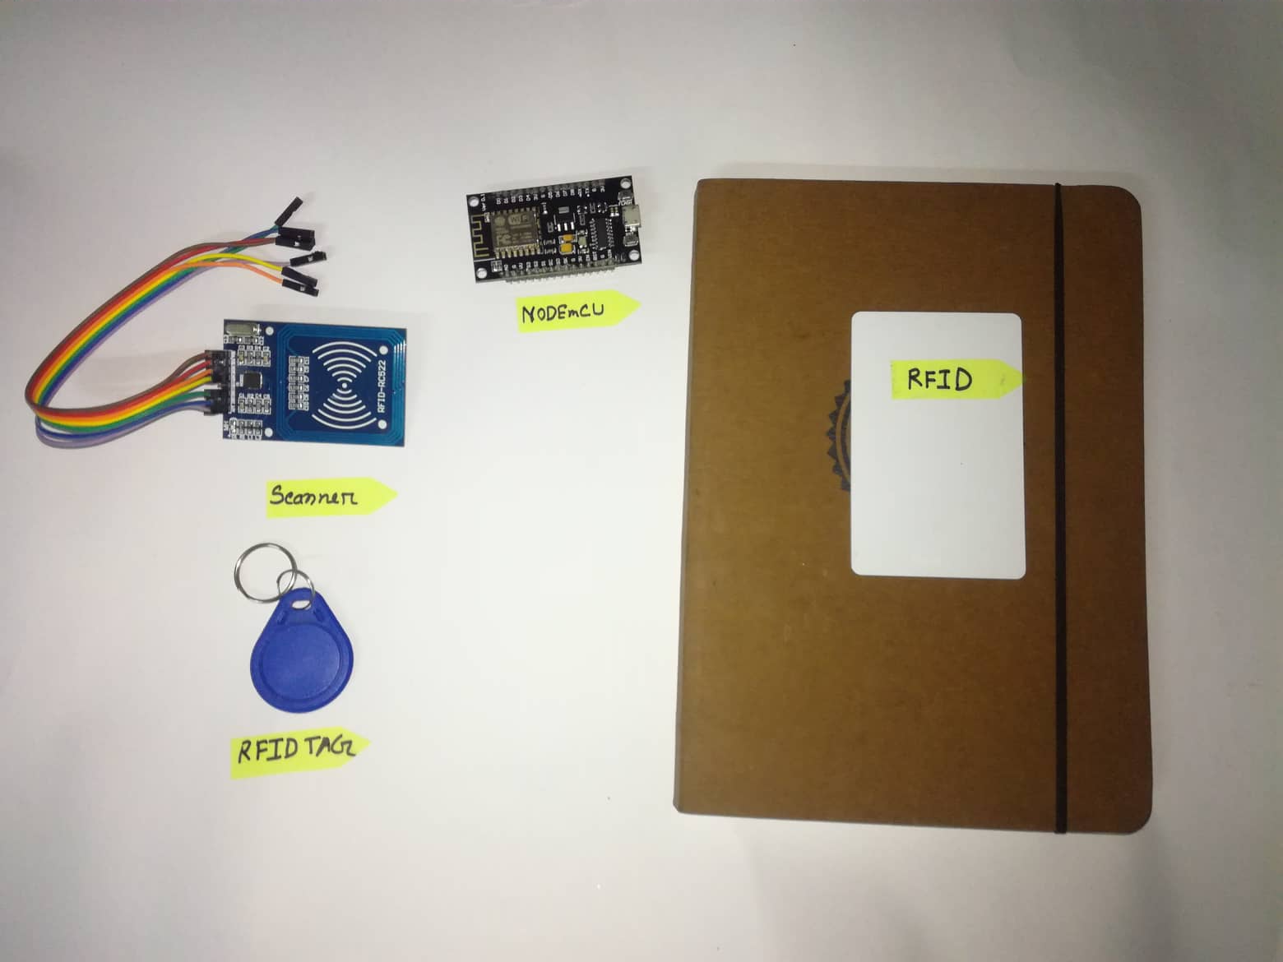
Components
RFID tag
Scanner
NODEmCU

Slide 4
ERD

Slide 5
Schema

Slide 6
Future plan
APP for Android
More security measurement
Mobility

Slide 7
Thank you

